Slide 1
ffmpeg

Slide 2
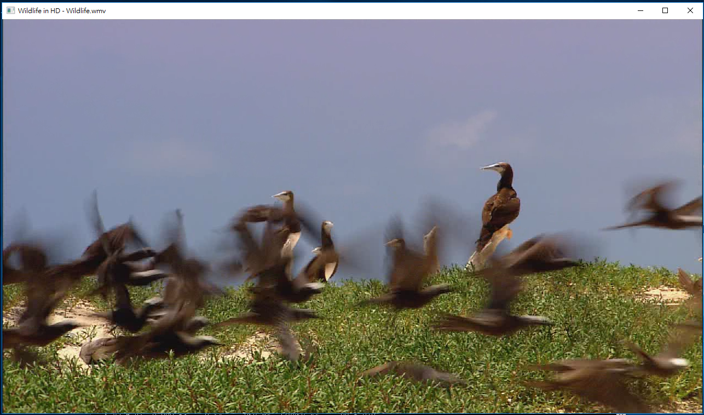
播放本地影片

Slide 3
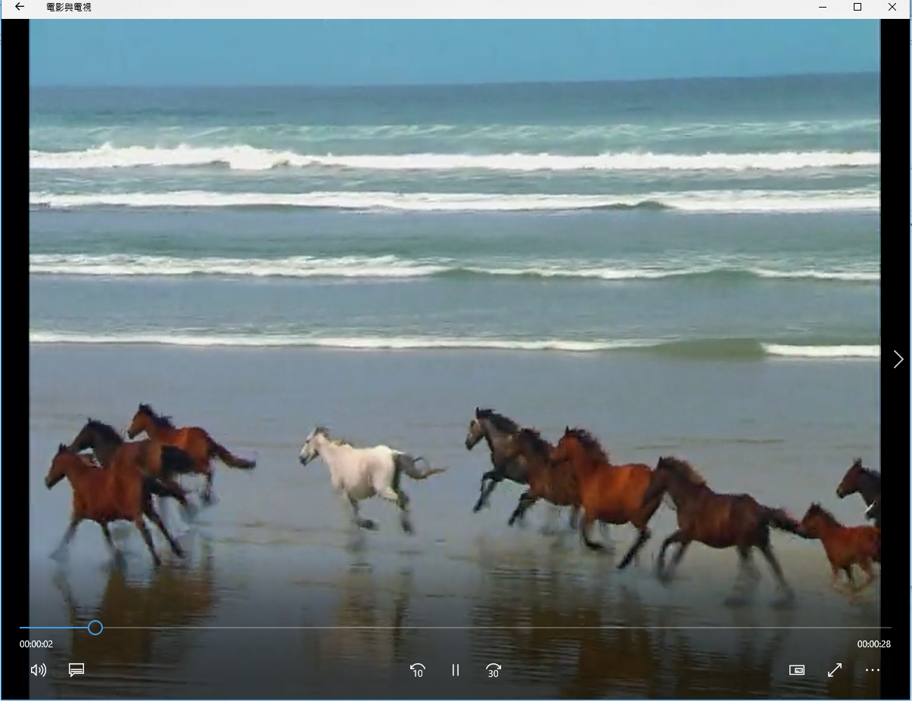
轉檔 wmv➔mp4

Slide 4
ffmpeg -re -i Wildlife.wmv -vcodec h264 -b:v 1M -b:a 256K -s 720x576 3.mp4

